Slide 1
Abstract
The rapid digitization of professional services has transformed the way legal consultations are delivered, creating opportunities for more accessible and efficient client–lawyer interactions. This project proposes the development of a Virtual Legal Advisory and Case Management System, a real-time digital portal designed to streamline legal services through secure virtual appointments, case tracking, and document management. Built on the MERN stack, the platform leverages WebRTC to enable seamless video consultations between clients and legal advisors. Clients can securely upload legal documents in PDF format, track the status of their cases, and receive automated email reminders for appointments and case updates. The system ensures authentication and role-based access using JWT (JSON Web Tokens), while an admin dashboard facilitates oversight of user activity, appointments, and compliance. By integrating video conferencing, document handling, and real-time case management into a single platform, the system reduces geographical barriers, minimizes paperwork, and enhances transparency. This solution has the potential to modernize traditional legal services, providing a more efficient, secure, and client-friendly approach to legal advisory and case management.
Keywords : Virtual Legal Advisory, Case Management System, Real- Time Consultation, WebRTC, MERN Stack, JWT Authentication.

Slide 2
INTRODUCTION
The legal industry is one of the oldest and most traditional professions, deeply rooted in manual processes, in-person consultations, and physical documentation. However, with the advancement of digital technologies and the increasing demand for online services, there is a pressing need to modernize how legal services are delivered and consumed. In recent years, digitization has reshaped various domains such as healthcare, finance, and education, and the legal sector is beginning to experience a similar transformation. A Virtual Legal Advisory and Case Management System provides a framework for bridging the gap between lawyers and clients by leveraging real-time digital tools for legal consultations, case tracking, and secure document management.
The traditional legal consultation process often involves physical visits to law offices, manual document submission, and repetitive communication delays. These barriers make legal assistance expensive, time-consuming, and inaccessible to many individuals, particularly those in remote areas. Moreover, the reliance on physical records introduces risks such as loss, mismanagement, and confidentiality breaches. To address these issues, the integration of modern information and communication technologies (ICTs) into the legal industry is both necessary and timely. By creating a digital platform where lawyers and clients can connect seamlessly, legal services can become more efficient, transparent, and inclusive.

Slide 3
The emergence of web technologies and cloud-based solutions has enabled the development of online platforms that go beyond simple communication tools. With the use of frameworks such as the MERN stack (MongoDB, Express.js, React.js, and Node.js), it becomes possible to build scalable and interactive platforms capable of handling large amounts of legal data, documents, and consultations. These technologies empower the system to deliver user-friendly interfaces, efficient database operations, and secure transactions, making it an ideal choice for building an online legal advisory portal.
One of the core innovations in this system is the inclusion of real-time video consultations powered by WebRTC. Legal consultations often require nuanced discussions that cannot be fully addressed through text or email communication alone. WebRTC enables encrypted peer-to-peer video communication directly from a web browser without the need for third-party plugins, thus allowing lawyers and clients to interact virtually as if in a face-to-face consultation. This ensures that clients receive professional guidance instantly while reducing travel costs and delays associated with in-person meetings.
The platform further incorporates secure document management, which is critical in the legal industry where contracts, affidavits, evidence, and case files form the backbone of client–lawyer interactions. By supporting PDF uploads, the system ensures standardized document handling while maintaining compatibility across devices and platforms. These documents are stored securely, with access restricted through role-based authentication, ensuring that sensitive client data remains confidential and protected against unauthorized access.

Slide 4
Another vital feature of the system is case tracking, which allows clients to monitor the progress of their cases in real time. Traditionally, clients depend on phone calls, emails, or office visits to stay updated on case proceedings, which often leads to communication gaps and frustration. Through this digital portal, clients can view case milestones, hearing schedules, and lawyer updates directly from their dashboard. This improves transparency and builds trust in the client–lawyer relationship by ensuring that clients are always informed about the status of their cases.
The system also integrates JWT (JSON Web Tokens) for authentication and secure role-based access control. In the legal domain, maintaining confidentiality and preventing unauthorized access to documents and consultations is paramount. JWT provides a lightweight and stateless mechanism for authentication, ensuring that each user session is secure while reducing the overhead associated with managing traditional session-based authentication systems. By assigning roles (e.g., client, lawyer, administrator), the platform ensures that each user has access only to the functionalities and data relevant to their role.
An admin dashboard forms another cornerstone of the platform, offering a comprehensive overview of users, appointments, and documents. Administrators can monitor system activities, ensure compliance with legal data standards, and intervene when necessary to resolve disputes or technical issues. This centralized control not only enhances security but also ensures accountability and smooth operation of the platform.

Slide 5
LITRATURE REVIEW
The adoption of technology in the legal profession has been steadily increasing, particularly in areas of digital communication, document management, and client engagement. Research shows that LegalTech solutions have transformed law firms’ operations by automating repetitive processes, improving access to resources, and reducing administrative burdens [1]. Cloud-based platforms, in particular, have enabled legal professionals to store, retrieve, and share case-related information without geographical restrictions, fostering flexibility and accessibility [2]. These advancements form the foundation for systems like the Virtual Legal Advisory and Case Management System, which integrates real-time consultation with robust case tracking and document handling features.
Several studies highlight the importance of remote legal consultations as an emerging necessity. For instance, post-COVID-19 research by the American Bar Association emphasized that clients increasingly prefer online consultations over in-person meetings, citing cost savings, time efficiency, and reduced travel burdens [3]. Similarly, WebRTC-based communication frameworks have been successfully implemented in healthcare and education, proving their reliability and scalability for sensitive consultations [4]. Extending these technologies to the legal domain ensures secure, encrypted, and real-time lawyer–client interactions, aligning with privacy and confidentiality requirements.

Slide 6
Another significant area of literature focuses on case management systems. Traditional case tracking often relied on manual registers or isolated software solutions, which lacked integration and transparency. Modern legal management tools, however, emphasize workflow automation, task scheduling, and client notifications [5]. For example, studies on legal practice management systems demonstrate that automated reminders significantly reduce missed appointments and deadlines, improving both lawyer productivity and client satisfaction [6]. The proposed system builds on these insights by incorporating automated email reminders and centralized dashboards to streamline case monitoring.
The role of document management in legal practice has also been widely studied. Legal professionals deal with vast amounts of paperwork, including contracts, affidavits, and evidence, which require secure storage and version control. Research on cloud-based document systems indicates that digitization enhances retrieval speed, reduces risks of data loss, and improves collaboration between legal teams [7]. Moreover, the inclusion of PDF handling features allows clients to upload evidence and lawyers to annotate or review documents in real time. This approach addresses the inefficiencies of paper-based workflows while maintaining data integrity and compliance.
Security and data confidentiality are recurring themes in literature concerning digital legal services. Studies on digital justice systems emphasize the critical need for role-based access control, authentication, and encryption to safeguard sensitive client data [8].

Slide 7
Several scholars have examined the barriers to digital adoption in the legal profession. Resistance to change, lack of digital literacy among lawyers, and concerns over cybersecurity are among the most cited challenges [10]. However, evidence also suggests that younger clients and tech-savvy legal practitioners are driving a cultural shift, demanding digital-first solutions [11]. The Virtual Legal Advisory and Case Management System aligns with these trends by offering an intuitive interface and user-friendly workflows that lower adoption resistance while maintaining compliance with legal ethics.
Existing literature also draws parallels between telemedicine platforms and virtual legal systems, noting that both fields deal with confidential consultations, sensitive records, and regulatory oversight [12]. Studies in telemedicine demonstrate that video consultation platforms significantly increase access for rural and underserved populations, a lesson that can be directly applied to legal services [13]. By offering remote consultations, the system ensures that clients in rural areas are not deprived of professional legal advice, thereby bridging the urban-rural justice divide.
The evolution of virtual advisory platforms has been discussed extensively in research surrounding digital justice. Many legal scholars argue that the legal industry has historically lagged behind other professional sectors in adopting technology, primarily due to its conservative nature and strong adherence to tradition [15]. However, recent advancements in cloud computing and web-based services have paved the way for innovative solutions that integrate consultation, case management, and secure communication into unified systems [16]. These advancements serve as strong precedents for developing a Virtual Legal Advisory and Case Management System that aligns with both modern expectations and legal standards.

Slide 8
EXISTING SYSTEM
The existing systems in the legal domain are largely built around traditional face-to-face interactions, physical court hearings, and in-office legal consultations. In most cases, clients must personally visit law firms or courts to seek advice, submit case-related documents, or follow up on legal proceedings. This dependency on physical interactions creates multiple barriers such as geographic limitations, time constraints, and high costs. For example, clients living in rural or remote areas may struggle to access qualified lawyers without traveling significant distances. Similarly, working professionals often face difficulties in scheduling in-person consultations during standard business hours. Even though some lawyers have adopted basic digital tools such as emails, phone calls, and simple document sharing via cloud drives, these fragmented methods do not offer an integrated platform for legal consultation, case tracking, and document management.
Several online legal service providers have emerged in recent years, such as LegalZoom, Rocket Lawyer, and Clio, but they often focus on specific services like contract templates, document filing, or firm management tools rather than offering a fully comprehensive virtual advisory and case-tracking platform. These platforms are typically subscription-based and may not be affordable for all clients, particularly individuals from low-income backgrounds seeking basic legal advice. Additionally, many of these services are designed for developed countries, leaving a gap in accessibility for developing regions where the need for affordable, real-time legal consultation is far greater.

Slide 9
Another limitation of the existing system is the lack of real-time communication tools integrated into legal advisory platforms. While some services allow clients to schedule appointments online, the actual consultation often still takes place in person or via unsecure communication channels such as WhatsApp or Skype, which are not specifically designed for handling sensitive legal information. These methods raise serious privacy and security concerns, since legal data involves confidential case details, personal identification, and sensitive financial information. Furthermore, without a structured case management framework, clients often have to rely on repeated follow-ups with lawyers to stay updated, resulting in frustration and lack of transparency.
In addition, the document handling process in existing systems remains inefficient. While PDF sharing and email-based communication are common, they are prone to disorganization, version mismatches, and data loss. There are few systems that provide a dedicated repository where clients and lawyers can securely upload, categorize, and retrieve legal documents with proper access controls. Moreover, there is no standardized mechanism to integrate document upload, case tracking, video consultation, and automated notifications within a single user-friendly environment.
Overall, the existing systems are fragmented, inefficient, and heavily dependent on manual processes. They fail to provide the end-to-end digital ecosystem that modern clients demand in an increasingly connected world. There is a clear need for a comprehensive solution that integrates real-time video consultations, secure case management, structured document handling, automated reminders, and administrative oversight, which the proposed system aims to deliver.

Slide 10
The current legal consultation landscape still predominantly relies on in-person interactions between lawyers and clients. For decades, clients have had to physically visit law firms, courts, or legal aid offices to obtain advice, submit petitions, or follow up on their case progress. While this approach allows for direct communication and personal interaction, it is burdened by inefficiencies such as long waiting times, geographical limitations, and high consultation costs. For instance, in many developing countries, clients must travel several kilometers to urban centers just to meet a legal professional, which creates barriers to justice for those residing in remote or rural areas. Moreover, the reliance on manual paperwork further delays processes, as physical files can be misplaced, lost, or damaged, resulting in additional burdens for both clients and lawyers.
Some modern firms have adopted semi-digital solutions, such as using email, cloud drives (Google Drive, Dropbox), or messaging platforms (WhatsApp, Telegram) for communication and document sharing. While these tools do improve convenience, they lack the integration and security features required for sensitive legal operations. Emails, for example, can easily become disorganized, with important documents scattered across multiple threads. Messaging applications, although widely accessible, are not designed for professional case management, as they do not support structured workflows, role-based access, or data encryption suitable for confidential legal exchanges. As a result, these semi-digital practices do not resolve the core issues of transparency, document security, and client tracking.

Slide 11
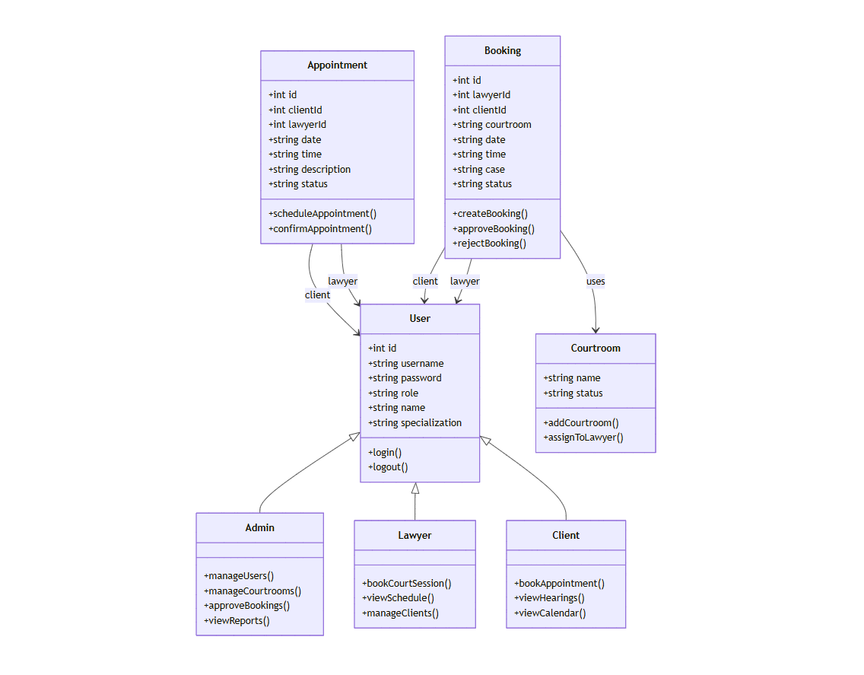
PROPOSED SYSTEM
The class diagram for the Virtual Legal Advisory and Case Management System illustrates the major entities and their interactions, capturing the structural design of the platform. At the core of the system is the User class, which represents the different actors in the system, including Admin, Lawyer, and Client. Each user has attributes such as id, username, password, role, name, and specialization, ensuring that the system can distinctly manage user identities and access rights. The operations login() and logout() define the authentication mechanism that allows users to securely enter and exit the system. The role-based structure ensures that each user interacts with the system according to their specific responsibilities, creating a clear separation of concerns.

Slide 12
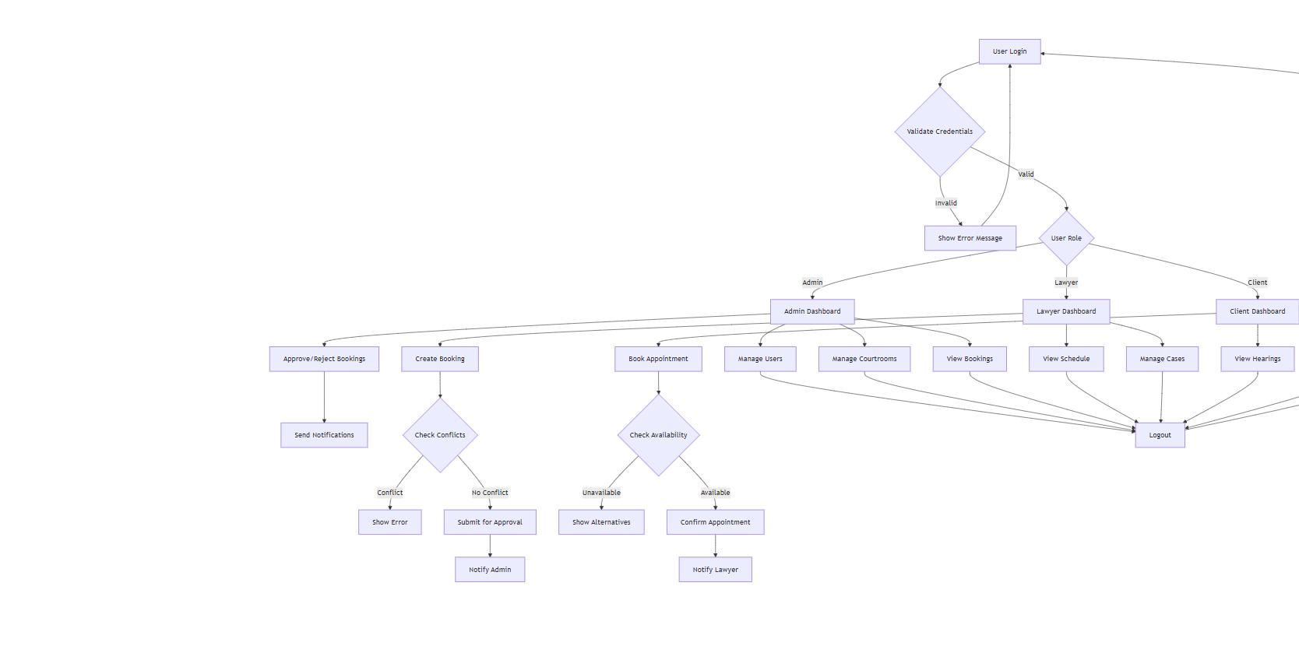
Flow Chart Diagram
The flow of the Virtual Legal Advisory and Case Management System begins with the User Login process. Every user—whether an admin, lawyer, or client—must first enter their credentials. The system then performs a validation check to verify the provided credentials. If the credentials are invalid, the system immediately returns an error message and denies access. However, if the login is successful, the system checks the User Role to determine the type of user accessing the application. This role-based access ensures that admins, lawyers, and clients each receive a customized dashboard with only the functionalities relevant to them.

Slide 13
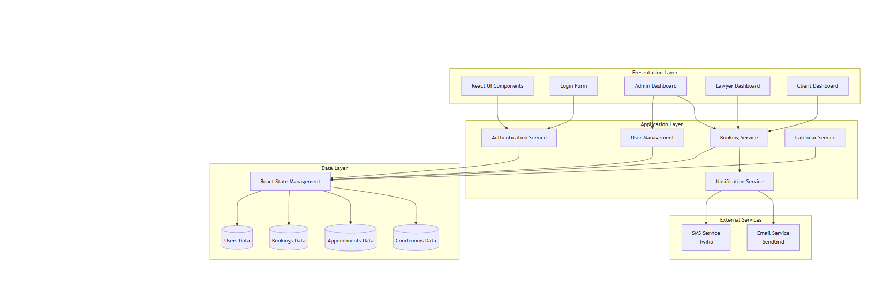
Architecture Diagram
The architecture of the Virtual Legal Advisory and Case Management System is designed as a multi-layered structure, ensuring modularity, scalability, and ease of maintenance. At the top of the structure lies the Presentation Layer, which provides the user interface and interaction components. This layer includes essential modules such as React UI Components, Login Form, Admin Dashboard, Lawyer Dashboard, and Client Dashboard. The presentation layer acts as the primary entry point for all users, ensuring that each role is provided with a customized and role-specific interface. For instance, the admin dashboard allows administrators to manage users and courtrooms, the lawyer dashboard provides tools to handle bookings and case schedules, and the client dashboard enables clients to book appointments and track hearings. By separating presentation concerns, the system ensures a seamless and intuitive user experience while maintaining flexibility for future enhancements.

Slide 14
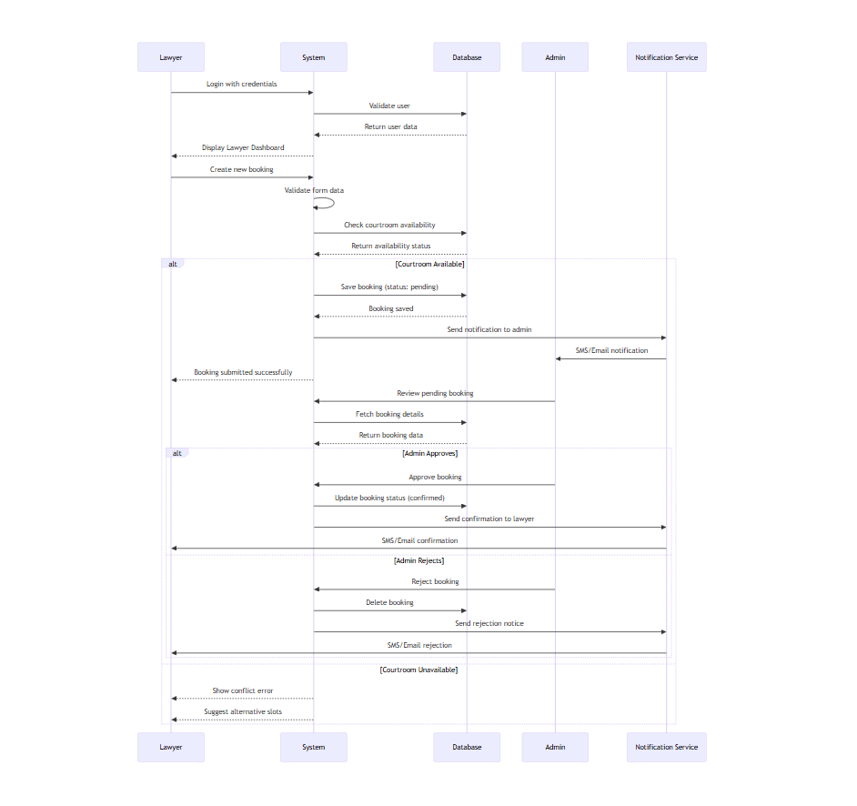
Sequence Diagram
The sequence diagram provides a detailed view of how different components and actors interact in the booking process of the Virtual Legal Advisory and Case Management System. It focuses on the step-by-step flow of events starting from the lawyer initiating a booking to the final confirmation or rejection, along with notifications being sent to the concerned parties.The process begins when a lawyer logs in with their credentials. The system validates these credentials against the stored records in the database. Once verified, the system retrieves the corresponding user data and displays the lawyer dashboard, allowing the lawyer to proceed with further actions.

Slide 15
IMPLEMENTATION AND TESTING
The implementation of the Virtual Legal Advisory and Case Management System was carried out in a structured and modular way to ensure scalability, maintainability, and ease of integration. The system was built using the MERN stack (MongoDB, Express.js, React.js, and Node.js), which provides a robust environment for developing full-stack web applications. The choice of this stack enabled seamless communication between the frontend and backend, as well as efficient handling of large amounts of legal case and appointment data.
At the frontend, React.js was used to design dynamic and interactive user interfaces for clients, lawyers, and administrators. The component-based architecture of React allowed reusability of modules such as login forms, booking dashboards, appointment calendars, and notification panels. React state management was used to track user sessions and display real-time updates on appointments, bookings, and case progress.
The backend was implemented using Node.js with Express.js as the web framework. Express.js was responsible for defining routes for user authentication, booking creation, appointment scheduling, and courtroom management. The backend was designed to be RESTful, ensuring a standardized way for the frontend to communicate with the server using JSON APIs. Sensitive operations such as login and booking approvals were secured using JWT (JSON Web Token) for authentication and authorization.

Slide 16
For the database, MongoDB was chosen due to its flexibility in handling unstructured and semi-structured legal data. Collections were created for users, appointments, bookings, and courtrooms, each with specific attributes defined in the entity-relationship design. This schema-less database structure provided adaptability for future enhancements, such as storing digital evidence or case documents. Indexing and query optimization techniques were applied to ensure efficient retrieval of appointment and booking data.
An important aspect of implementation was real-time communication and notifications. Using third-party services such as Twilio for SMS notifications and SendGrid for email services, users were instantly informed about booking confirmations, rejections, or appointment reminders. This ensured that no stakeholder missed important legal updates.
The admin dashboard was designed to provide administrators with complete control over the system. From here, admins could manage users, approve or reject bookings, allocate courtrooms, and generate activity reports. Lawyers were provided with a dashboard to view their upcoming hearings, manage client appointments, and track schedules. Clients, on the other hand, could easily book appointments, upload documents, and check the status of their cases.

Slide 17
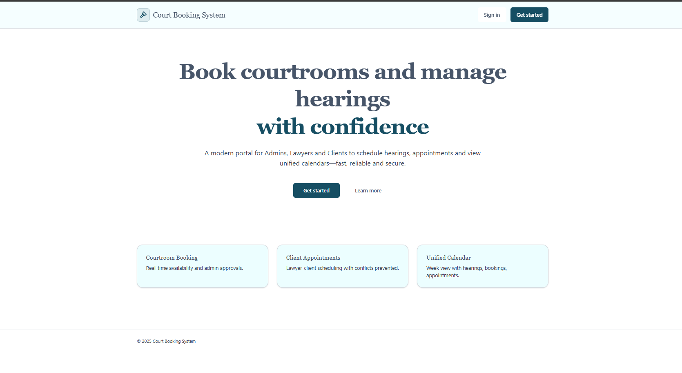
RESULTS
This screen represents the homepage of the Court Booking System, which introduces the platform’s purpose and key functionalities in a clear and professional manner. The main heading highlights the system’s core objective—to enable courtroom bookings and hearing management with confidence—which reassures users about the reliability and security of the platform. Below this, the description emphasizes that it is a modern digital portal designed for admins, lawyers, and clients to streamline the scheduling of hearings and appointments while also providing access to unified calendars. The language used conveys trust, efficiency, and convenience, making it appealing to legal professionals and clients alike.

Slide 18
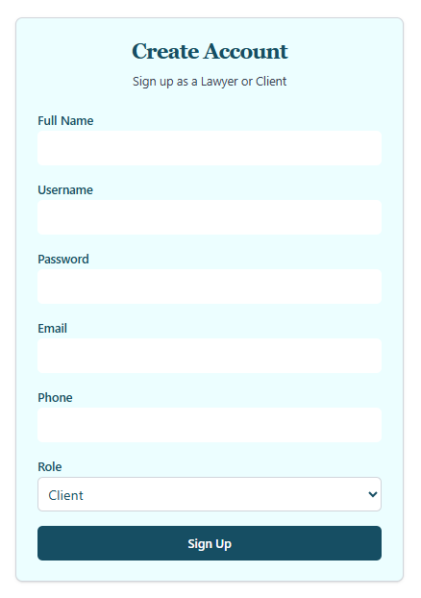
Sign Up Form
This image shows a straightforward web page for creating a new user account. The main heading, "Create Account," is clearly displayed at the top, followed by a smaller subheading that specifies the purpose: "Sign up as a Lawyer or Client." The form itself is designed with several input fields, each with a clear label to guide the user. These fields, from top to bottom, are for the user's Full Name, Username, Password, Email, and Phone number. Each field is represented by a blank, elongated box, inviting the user to type in their information. Below the standard text input fields, there is a dropdown menu for "Role," which allows the user to select whether they want to register as a Lawyer or a Client; the menu is currently set to "Client."

Slide 19
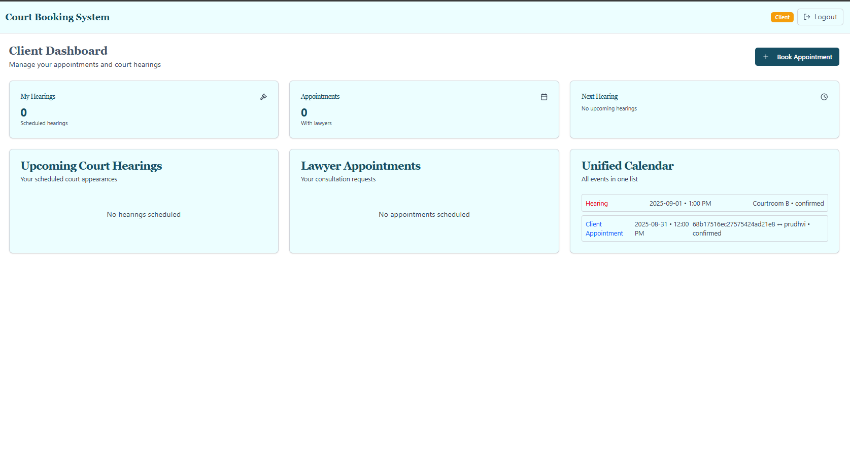
Court Booking System
This image presents the comprehensive Client Dashboard for a Court Booking System, a user interface designed to give clients a unified and organized view of their legal-related activities. Upon logging in, the user is greeted with a clean and professional layout, featuring the main title "Client Dashboard" and the purpose statement, "Manage your appointments and court hearings." The top right corner of the screen confirms the user's role as a "Client" and provides a convenient "Logout" button.The dashboard is composed of several modular widgets, each serving a specific function.

Slide 20
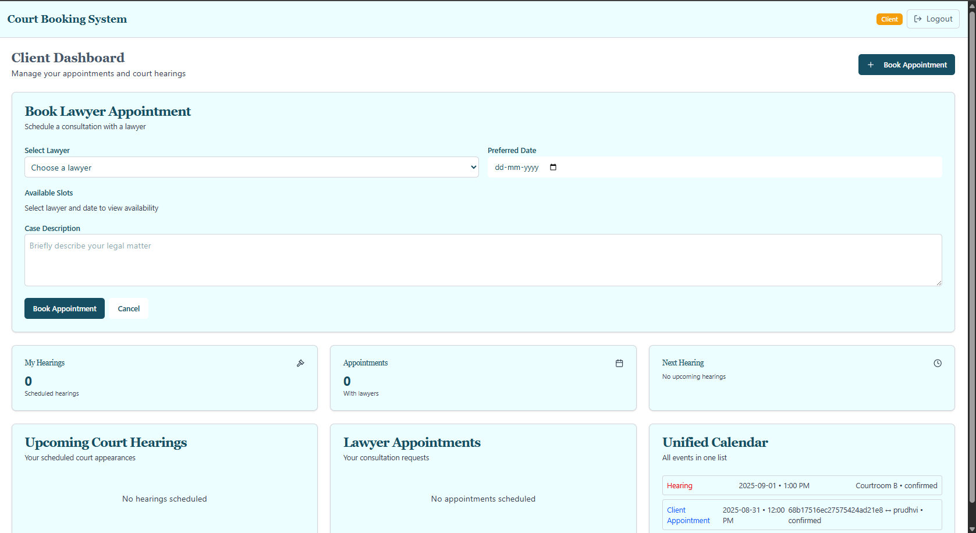
Court Booking System
This image provides a detailed view of the "Book Lawyer Appointment" feature within a client's dashboard of a Court Booking System. The primary focus is a large form designed to facilitate a consultation booking with a lawyer. The form is clearly titled, with the subheading "Schedule a consultation with a lawyer," guiding the user through the necessary steps. The fields include a dropdown menu to "Select Lawyer," a calendar field to choose a "Preferred Date" (formatted as dd-mm-yyyy), and a section designated for showing "Available Slots" once a lawyer and date are selected. A significant portion of the form is a large text box for the user to provide a "Case Description," with the prompt, "Briefly describe your legal matter," allowing the client to provide context for their appointment. At the bottom of this booking form are two buttons: a prominent blue "Book Appointment" button to finalize the request and a "Cancel" button to discard the input.

Slide 21
CONCLUSION
The Court Booking System represents a significant advancement in the digital transformation of legal services by providing a centralized and efficient platform for managing courtroom reservations, client appointments, and legal proceedings. Traditional methods of courtroom scheduling often rely on manual processes, physical paperwork, or fragmented communication channels, which frequently lead to double bookings, missed hearings, and delays in case proceedings. This project addresses these challenges by introducing a robust online system that ensures transparency, accessibility, and streamlined coordination among administrators, lawyers, and clients.
The system’s core functionalities—including real-time courtroom booking, lawyer-client appointment management, and a unified calendar view—demonstrate how technology can simplify complex workflows within the judicial ecosystem. By automating scheduling and reducing human intervention, the platform minimizes errors while simultaneously enhancing productivity. Lawyers benefit from easier appointment management and better time allocation, clients gain faster access to legal consultations, and administrators maintain greater control over courtroom availability, ensuring optimal utilization of resources.

Slide 22
FUTURE SCOPE
The Court Booking System, while already addressing major challenges in courtroom and appointment management, has vast potential for further expansion and enhancement to make it even more comprehensive and impactful. As the legal sector increasingly embraces digital transformation, there is scope to integrate advanced technologies and broaden the system’s functionalities to better serve administrators, lawyers, and clients alike. One of the most promising future enhancements is the integration of Artificial Intelligence (AI) and Machine Learning (ML) to enable intelligent scheduling and conflict prediction. For example, AI could analyze historical booking patterns, lawyer availability, and case urgency to automatically suggest the most suitable time slots for hearings and consultations, thereby reducing scheduling delays and enhancing efficiency.
Another important area of development lies in mobile application support. With the increasing reliance on smartphones, a mobile-friendly version or dedicated app would allow lawyers, clients, and administrators to access the system on the go, receive instant notifications about hearings or appointment updates, and manage their schedules more flexibly. The system can also be integrated with cloud infrastructure, enabling seamless scalability and ensuring secure data storage with minimal downtime. This would be especially beneficial for large-scale adoption across multiple courts or judicial institutions where thousands of users need to access the platform simultaneously.

Slide 23
REFRENCES
Chukwuemeka, O., & Adepoju, O. (2020). Design and implementation of an online court case management system. International Journal of Computer Applications, 176(36), 1–7. https://doi.org/10.5120/ijca2020920183
Gupta, A., & Yadav, R. (2021). E-court management system: A step towards digital judiciary. International Journal of Innovative Research in Computer and Communication Engineering, 9(3), 123–130.
Odeh, A., & Al-Hasan, M. (2019). An automated scheduling system for courts using online booking platforms. Journal of Information Technology Research, 12(2), 45–58.
Bhatia, P., & Jain, M. (2018). Online appointment scheduling systems: A comparative study. International Journal of Advanced Research in Computer Science, 9(5), 77–82.
Adeyemi, T., & Oladipo, S. (2022). The role of technology in modernizing judicial processes: Case of e-court systems. African Journal of Computing & ICT, 15(1), 33–41.

Slide 24
Sharma, K., & Mehta, A. (2020). Blockchain-based secure court record management system. IEEE Access, 8, 144123–144131. https://doi.org/10.1109/ACCESS.2020.3015099
Agarwal, S., & Kumar, V. (2021). Artificial Intelligence in legal services: Opportunities and challenges. International Journal of Law and Technology, 13(2), 87–95.
United Nations Office on Drugs and Crime (UNODC). (2020). E-justice: Digital solutions for courts. Retrieved from https://www.unodc.org/
Ministry of Law & Justice, Government of India. (2019). E-Courts Project Phase II: Policy and Action Plan Document. Retrieved from https://doj.gov.in
National Center for State Courts (NCSC). (2018). Trends in state courts: The future of court technology. Williamsburg, VA: NCSC Press.

